Slide 1


Insert relevant picture related to the topic
ALGORITHMS AND DATA STRUCTURES
TEB1113/TFB2023
WEEK I
INTRODUCTION TO DATA STRUCTURE
FARAHIDA HANIM BT MAUSOR - DR (FSMC/UTP)
BACHELOR OF XXXXXX
DEPARTMENT OF COMPUTING
FACULTY OF SCIENCE, MANAGEMENT & COMPUTING
© 2026 INSTITUTE OF TECHNOLOGY PETRONAS SDN BHD
All rights reserved. No part of this document may be reproduced, stored in a retrieval system or transmitted in any form or by any means (electronic, mechanical, photocopying, recording or otherwise) without the permission of the copyright owner.

Slide 2
LEARNING OUTCOMES
Classify data structures into primitive and non-primitive types.
Differentiate linear and non-linear data structures using examples.
Explain basic operations such as traversal, insertion, searching, sorting, and deletion.
Apply C++ struct, pointers, and arrays to design a simple record-based application..
Notes:
Learning Outcomes Slide
Note:
Include 2–4 lecture-level learning outcomes
Use measurable action verbs
Map explicitly to Course Learning Outcomes (CLOs)

Slide 3
TOPICS
What is a Data Structure?
Primitive Data Structures
Non-Primitive Data Structures
Linear vs Non-Linear Structures
4. C++ Practical
Notes:
Learning Outcomes Slide
Note:
Include 2–4 lecture-level learning outcomes
Use measurable action verbs
Map explicitly to Course Learning Outcomes (CLOs)

Slide 4
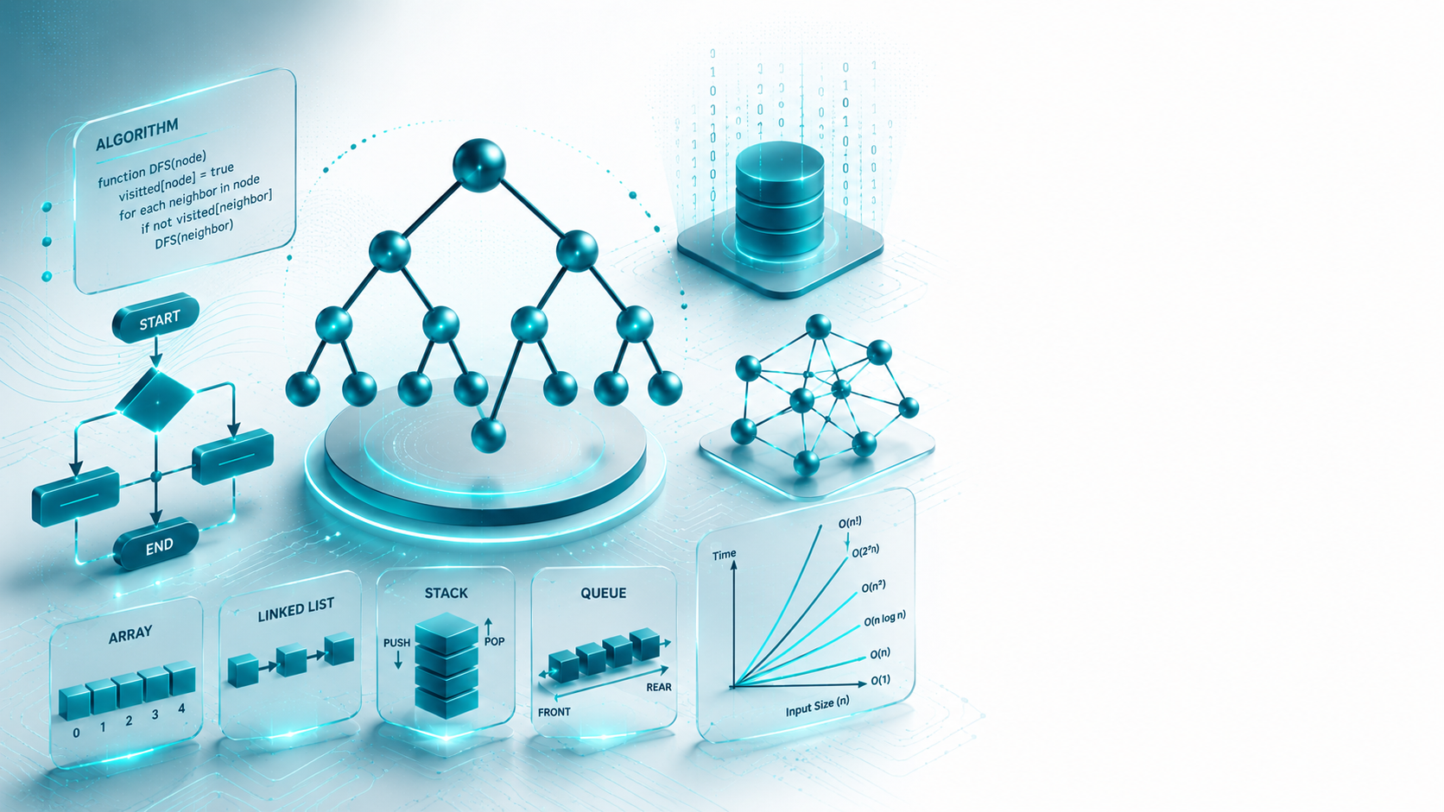
INTRODUCTION TO DATA STRUCTURE
Introduction

Slide 5
INTRODUCTION
1.1. DEFINITION OF DATA STRUCTURES
DATA
Collection of raw facts and figures
DATA STRUCTURE
A way to organize, store, and relate data in memory
Notes:
Engagement and Activity Slides
Note:
Include at least one engagement element where appropriate:
Think–Pair–Share
Mini task
Poll or reflection question
Suggested duration: 3–5 minutes
Activities shall align with learning outcomes

Slide 6
INTRODUCTION
Data structures affect the design of both the structural and functional aspects of a program.
Program = Algorithm + Data Structure
But what is an Algorithm?
Notes:
Engagement and Activity Slides
Note:
Include at least one engagement element where appropriate:
Think–Pair–Share
Mini task
Poll or reflection question
Suggested duration: 3–5 minutes
Activities shall align with learning outcomes

Slide 7
INTRODUCTION
1.2. CLASSIFICATION OF DATA STRUCTURE
Data Structures are normally divided into two broad categories.
Primitive Data Structure
Non-Primitive Data Structure
Notes:
Engagement and Activity Slides
Note:
Include at least one engagement element where appropriate:
Think–Pair–Share
Mini task
Poll or reflection question
Suggested duration: 3–5 minutes
Activities shall align with learning outcomes

Slide 8
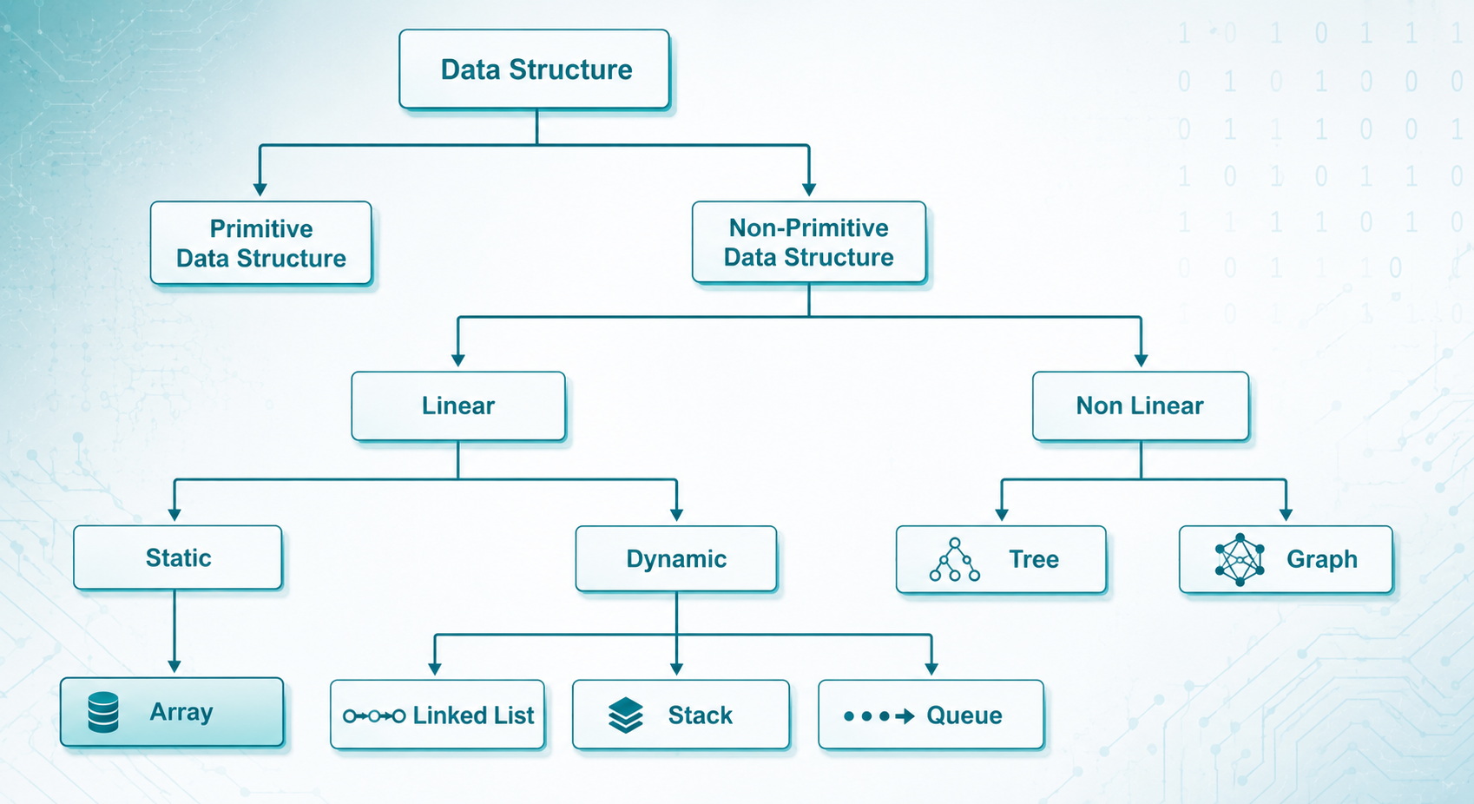
CLASSIFICATION OF DATA STRUCTURE
Notes:
Engagement and Activity Slides
Note:
Include at least one engagement element where appropriate:
Think–Pair–Share
Mini task
Poll or reflection question
Suggested duration: 3–5 minutes
Activities shall align with learning outcomes

Slide 9
INTRODUCTION TO DATA STRUCTURE
Primitive Data Structures

Slide 10
PRIMITIVE DATA STRUCTURES
2.1. DEFINITION AND EXAMPLES
There are basic structures that are directly operated upon by the machine instructions.
Data structures that are directly manipulated by machine-level instructions are known as primitive data structures.
Integer, Floating-Point number, Character Constants, String Constants, Pointers, etc., fall in this category.
Notes:
Engagement and Activity Slides
Note:
Include at least one engagement element where appropriate:
Think–Pair–Share
Mini task
Poll or reflection question
Suggested duration: 3–5 minutes
Activities shall align with learning outcomes

Slide 11
PRIMITIVE DATA STRUCTURES
2.2. COMMON OPERATIONS
The most commonly used operations on Data Structures are broadly categorized into the following types:
Create
Selection
Updating
Destroy or Delete
Notes:
Engagement and Activity Slides
Note:
Include at least one engagement element where appropriate:
Think–Pair–Share
Mini task
Poll or reflection question
Suggested duration: 3–5 minutes
Activities shall align with learning outcomes

Slide 12
INTRODUCTION TO DATA STRUCTURE
Non-Primitive Data Structures

Slide 13
NON-PRIMITIVE DATA STRUCTURES
3.1. DEFINITION AND EXAMPLES
They are more sophisticated Data Structures.
The Data Structures that are derived from the primitive Data Structures are called Non-Primitive Data Structures.
The non-primitive data structures emphasize on structuring of a group of homogenous (same type) or heterogeneous (different type) data items.
Notes:
Engagement and Activity Slides
Note:
Include at least one engagement element where appropriate:
Think–Pair–Share
Mini task
Poll or reflection question
Suggested duration: 3–5 minutes
Activities shall align with learning outcomes

Slide 14
NON-PRIMITIVE DATA STRUCTURES
3.2. LINEAR DATA STRUCTURES:
Linear Data Structures are a kind of Data Structure that has homogeneous elements.
The Data Structure in which elements are in a sequence and form a linear series.
Linear Data Structures are very easy to implement, since the memory of the computer is also organized linearly.
Some commonly used Linear Data Structures are Stack, Queue, and Linked Lists.
Notes:
Engagement and Activity Slides
Note:
Include at least one engagement element where appropriate:
Think–Pair–Share
Mini task
Poll or reflection question
Suggested duration: 3–5 minutes
Activities shall align with learning outcomes

Slide 15
NON-PRIMITIVE DATA STRUCTURES
3.3. NON-LINEAR DATA STRUCTURES:
A Non-Linear Data Structure is a Data Structure in which a data item is connected to several other data items.
Non-linear Data Structure may exhibit either a hierarchical relationship or a parent-child relationship.
The data elements are not arranged in a sequential structure.
The different non-linear Data Structures are trees and graphs.
Notes:
Engagement and Activity Slides
Note:
Include at least one engagement element where appropriate:
Think–Pair–Share
Mini task
Poll or reflection question
Suggested duration: 3–5 minutes
Activities shall align with learning outcomes

Slide 16
NON-PRIMITIVE DATA STRUCTURES
3.4. COMMON OPERATIONS
The most commonly used operations on Data Structures are broadly categorized into the following types:
Traversal
Insertion
Selection
Searching
Sorting
Merging
Destroy or Delete
Notes:
Engagement and Activity Slides
Note:
Include at least one engagement element where appropriate:
Think–Pair–Share
Mini task
Poll or reflection question
Suggested duration: 3–5 minutes
Activities shall align with learning outcomes

Slide 17
INTRODUCTION TO DATA STRUCTURE
Difference between Primitive and Non-Primitive Data Structures

Slide 18
DIFFERENCE BETWEEN PRIMITIVE AND NON-PRIMITIVE DATA STRUCTURES
FEATURE | PRIMITIVE | NON-PRIMITIVE
Meaning | Basic built-in type | Built using primitive types
Examples | int, float, char, pointer | array, linked list, tree, graph
Structure | Simple | Can store relationships
Memory use | Usually fixed/simple | Can be static or dynamic
Use case | Single value | Grouped or connected data
Notes:
Engagement and Activity Slides
Note:
Include at least one engagement element where appropriate:
Think–Pair–Share
Mini task
Poll or reflection question
Suggested duration: 3–5 minutes
Activities shall align with learning outcomes

Slide 19
CHARACTERISTICS OF DATA STRUCTURE
CORRECTNESS
The Data Structure implementation should implement its interface correctly.
TIME COMPLEXITY
The running time or the execution time of the operations of the Data Structure must be as small as possible.
SPACE COMPLEXITY
Memory usage of data structure operations should be as little as possible.

Slide 20
PRACTICAL EXAMPLE
4.1. WHAT IS A STRUCT?
A structure is a user-defined data type in C/C++.
A structure creates a data type that can be used to group items of different types into a single type.
The s𝑡𝑟𝑢𝑐𝑡 keyword is used to create a structure.
Notes:
Engagement and Activity Slides
Note:
Include at least one engagement element where appropriate:
Think–Pair–Share
Mini task
Poll or reflection question
Suggested duration: 3–5 minutes
Activities shall align with learning outcomes

Slide 21
PRACTICAL EXAMPLE
Let’s talk about Structures [struct] (in the language of C++)
𝑠𝑡𝑟𝑢𝑐𝑡 𝑠𝑡𝑟𝑢𝑐𝑡𝑢𝑟𝑒_𝑛𝑎𝑚𝑒
{
𝑑𝑎𝑡𝑎_𝑡𝑦𝑝𝑒 𝑚𝑒𝑚𝑏𝑒𝑟1;
𝑑𝑎𝑡𝑎_𝑡𝑦𝑝𝑒 𝑚𝑒𝑚𝑏𝑒𝑟2;
. . .
𝑑𝑎𝑡𝑎_𝑡𝑦𝑝𝑒 𝑚𝑒𝑚𝑒𝑏𝑒𝑟𝑁;
};

Slide 22
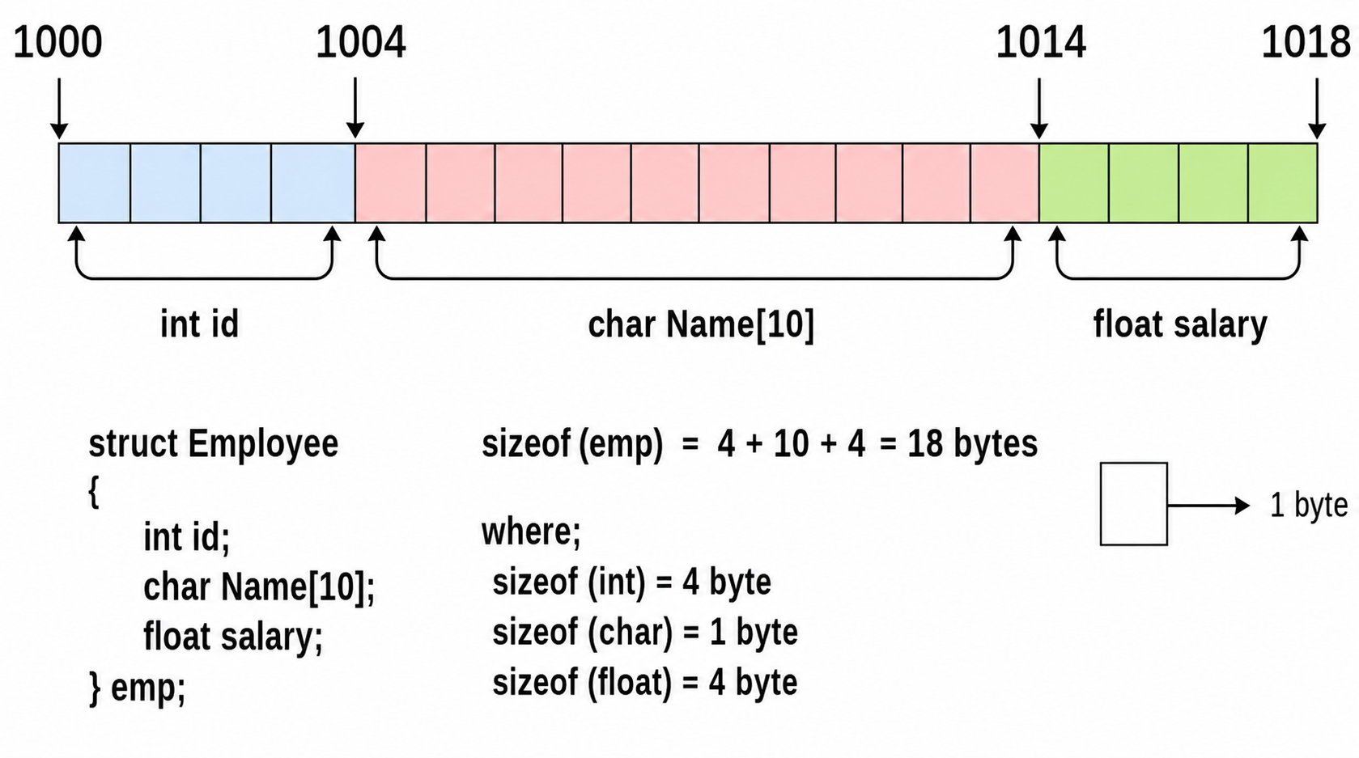
PRACTICAL EXAMPLE

Slide 23
SUMMARY
TODAY’S KEY TAKEAWAYS:
Data structures organize data for efficient use.
Primitive structures store basic values.
Non-primitive structures organize groups or relationships.
Linear structures follow a sequence; non-linear structures form relationships.
C++ struct helps group different data types into one record.
Notes:
Engagement and Activity Slides
Note:
Include at least one engagement element where appropriate:
Think–Pair–Share
Mini task
Poll or reflection question
Suggested duration: 3–5 minutes
Activities shall align with learning outcomes

Slide 24
LAB TASK
CREATE A C++ PROGRAM USING STRUCT AND ARRAYS
Your program should:
Store at least 5 student records.
Include student ID, name, age, course.
Display all records.
Search for a student by ID.
Update one student record.
Notes:
Engagement and Activity Slides
Note:
Include at least one engagement element where appropriate:
Think–Pair–Share
Mini task
Poll or reflection question
Suggested duration: 3–5 minutes
Activities shall align with learning outcomes

Slide 25

THANK YOU
FARAHIDA HANIM BT MAUSOR - DR (FSMC/UTP)
DEPARTMENT OF COMPUTING
farahida.mausor@utp.edu.my
02-03-26

